Slide 1

Minor Project-1
(CS6490)
The Crop Yield Prediction
Using Machine Learning

Slide 2

Group Members (Group 60)
Kshitij Khot (1906086)
Pranjal Mishra (1906024)
Priyanshu Bhardwaj (1906023)
Project Supervisor
Dr. Anushree Tripathi
Department of Computer Science and Engineering
NIT PATNA

Slide 3
Contents:
Motivation / Introduction
Problem?
Proposed Solution
Objective
Related works
6. System Architecture
7. Results
8. Conclusions
9. Future Scope
10. References

Slide 4

Objective
To bridge the gap between technology and agriculture sector:
By developing a predictive model using machine learning techniques
By proposing a user-friendly Web Interface to interact with the model
Encouraging farmers to get into the age of information.

Slide 5
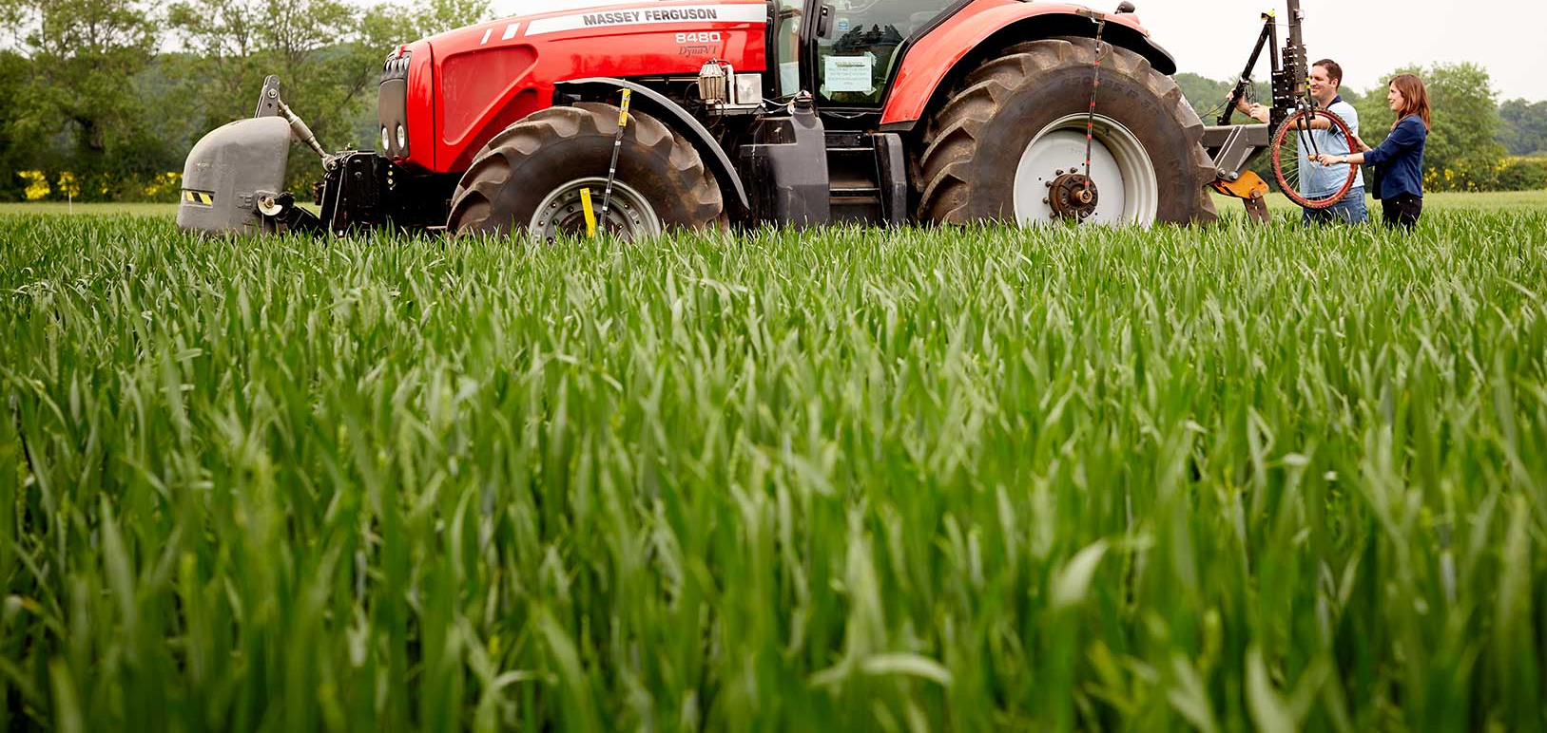

Motivation
In India, we all know that Agriculture is the backbone of the country.

Slide 6

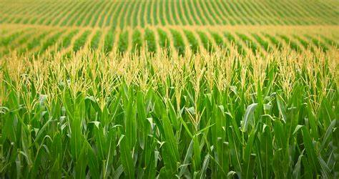
Agriculture
Driving catalyst for the rural economy
Not only an enormous aspect of the growing economy,
but it’s essential for us to survive
Food demand is anticipated to rise between 60 and 95% by 2050
However, Current Agricultural Techniques have some flaws.

Slide 7
What is the Problem?
Most of the farmers are unknown to fact that which crop can better grow in their farm because of lack of informations or wrong informations.
New sorts of hybrid varieties are produced day by day, but people are not aware which is gonna give more yield.
If some crop fails there is a huge loss on farmers head.
The unnatural techniques spoil the soil by making imbalance of nutrients.
In turn, creating huge losses, for long term as well.

Slide 8
Proposed Solution
A website where the user can enter the data related to the farming area such as area of land, location of the farm, etc and get the prediction of crop yield or the suggestion about which crop will be the most suitable for the user.
Due to the accurate information about the crop yield the loss factor over the farmer will get decreased.
It will increase the diversity of food across the country and help in improve of the soil quality too.

Slide 9
Related Works
There has been many researches on the crop yield prediction since the last decade.
We found some helpful research papers which have provided relevant idea to work.
Earlier efforts have been taking temperature, rainfall and other climatic factors to predict which made it cumbersome to fetch location and predict.

Slide 10

Our Work
We are going to predict the crop yield as well as we will be able to recommend the crop based on the location entered by the user
Crop Prediction
Crop Recommendation
Based on the location inputted By the user

Slide 11
Methodology
Preparing Data / Data PreProcessing
Selection of the algorithm having precise results
Random Forest Model for prediction
The System Architecture
System Analysis

Slide 12
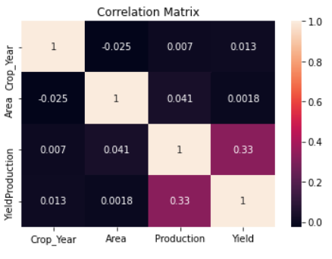
Step-1
Preparing the dataset
We collected the data from Indian Government Repository
Data cleaning
Divided the dataset into training and testing data (75:25)
Finally we had preprocessed data with feature selection

Slide 13
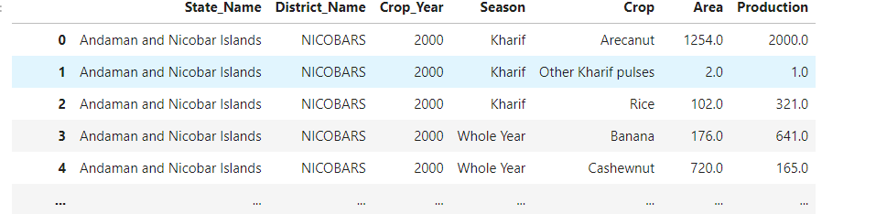
Dataset

Slide 14
Step -2
Selection of ML Algorithm
Employed the following algorithms
Linear Regression
Decision Tree
Random Forest
Random Forest ML algorithm gave the best yield prediction accuracy
References also support this
Algorithm | Accuracy
Linear Regression | 18.75 %
Decision Tree | 92.1678 %
Random Forest | 97.0679 %

Slide 15
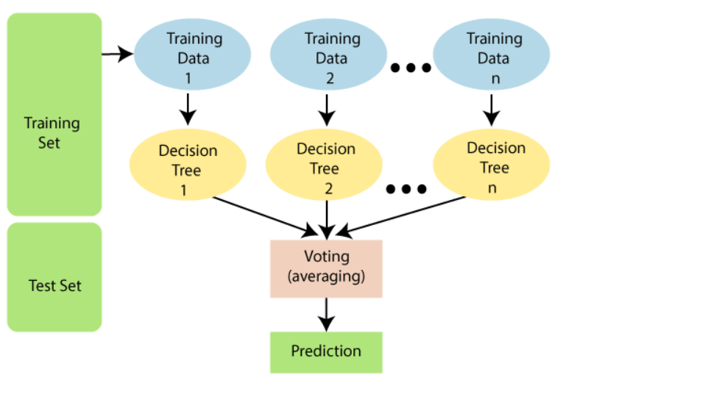
Step -3
Random Forest ML Algorithm
Source : javatpoint.com

Slide 16
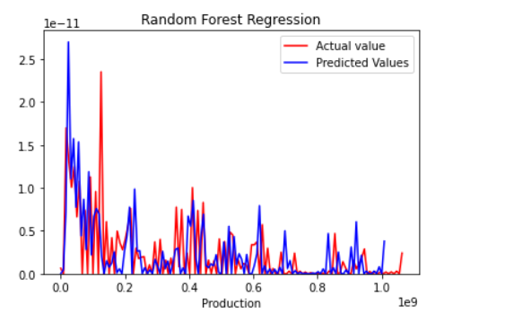
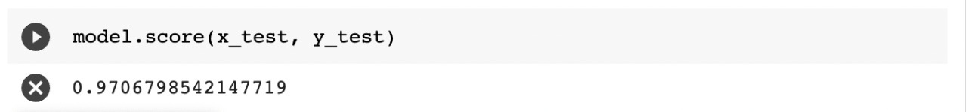
Random Forest ML Algorithm
Achieved the accuracy of 97.06 %

Slide 17
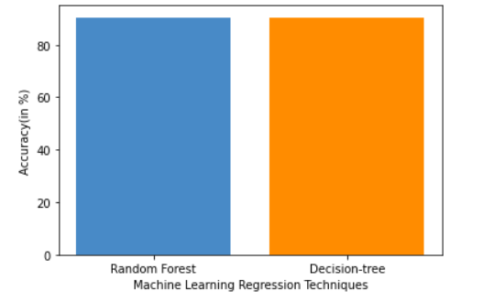
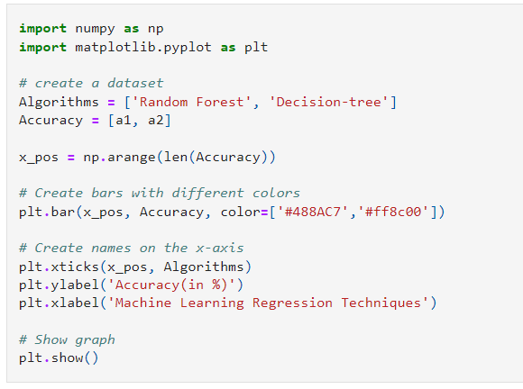
Random Forest ML Algorithm
In terms of accuracy Random Forest Algorithm is far better than Linear Regression and significantly more accurate than the decision trees.

Slide 18
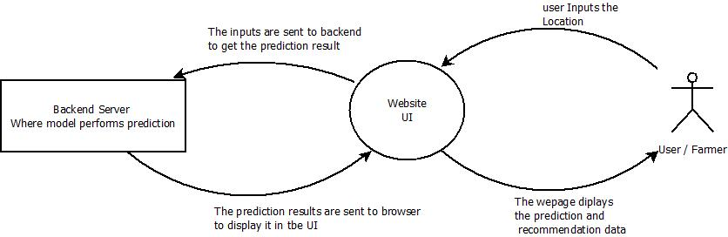
Step-4
System Architecture

Slide 19
System Architecture
A user-friendly website
A trained model in the backend server
User interacts with the system and gets the predictions.

Slide 20
Results
We have come up with a model which is used for crop prediction with its yield using machine learning techniques which were implemented on Jupyter notebook.
The Random Forest Algorithm came to be the most accurate predictor.

Slide 21
Results contd.
Developed a user friendly web application to interact with the model.
It is a react single-page application.
The web application portrays the crops with corresponding yields

Slide 22
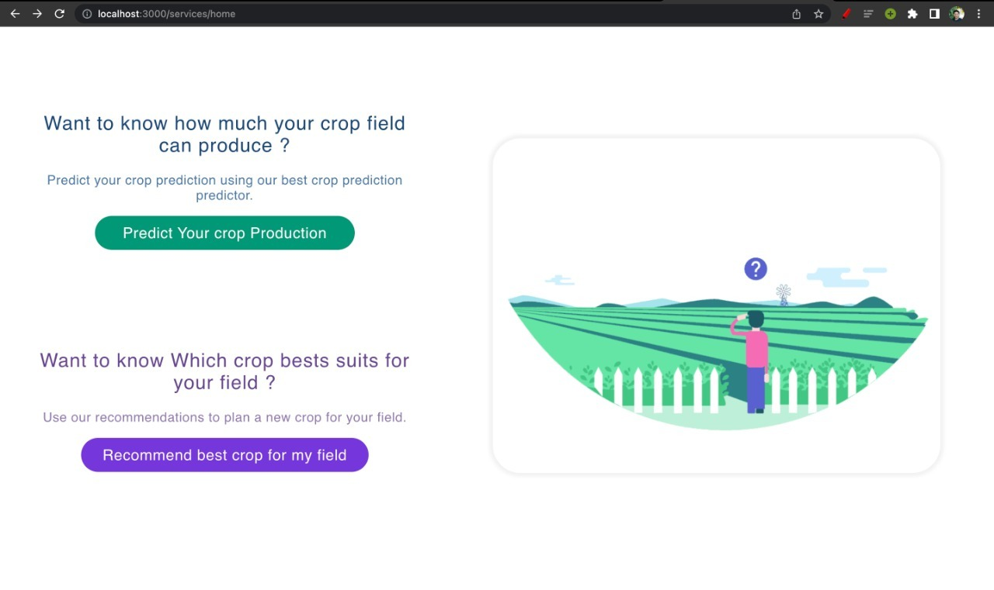
Results contd.
Developed a user friendly react web application to interact with the model.

Slide 23

Conclusions
This work presents an effective crop prediction system by using past data. Using Machine Learning model and functions datasets are analyzed and the trained model is used to fetch the crop based on region and season. This proposed system helps the farmers to select suitable crops based on season and region of sowing. It will in- turn help the farmers by reducing the loss faced by them and improve net crop yield.
This also contributes to our Indian economy by increasing the yield rate of crop production.

Slide 24
Future Scope
We can try applying data independent system i.e. our system should predict with same accuracy even though data is more or less.
Integrating soil details to our advantage, as a parameter.
We can predict whether and how much irrigation is required based on rainfall data.
So on…

Slide 25
References
Crop Yield Prediction based on Indian Agriculture using Machine Learning - 2020 International Conference for Emerging Technology (INCET) Belgaum, India. Jun 5-7, 2020
A reinforced random forest model for enhanced crop yield prediction by integrating agrarian parameters - Dhivya Elavarasan, · P. M. Durai Raj Vincent, Journal of Ambient Intelligence and Humanized Computing (2021)
Fuzzy deep learning-based crop yield prediction model for sustainable agronomical frameworks - Dhivya Elavarasan, · P. M. Durai Raj Vincent, Neural Computing and Applications (2021)
Emerging Trends in Machine Learning to Predict Crop Yield and Study Its Influential Factors: A Survey - Nishu Bali, Anshu Singla, Archives of Computational Methods in Engineering (2022)
Crop Yield Prediction Using Machine Learning Algorithms - Aruvansh Nigam, Saksham Garg , Archit Agrawal, Parul Agrawal, 2019 Fifth International Conference on Image Information Processing (ICIIP)
A Study on Various Data Mining Techniques for Crop Yield Prediction - Yogesh Gandge, Sandhya, 2017 International Conference on Electrical, Electronics, Communication, Computer and Optimization Techniques (ICEECCOT)
Crop Prediction using Machine Learning - M.Kalimuthu, P.Vaishnavi, M.Kishore, Proceedings of the Third International Conference on Smart Systems and Inventive Technology (ICCSIT 2020)
An efficient algorithm for predicting crop using historical data and pattern matching technique Anjana, Aishwarya Kedlaya K , Aysha Sana, B Apoorva Bhat, Sharath Kumar, Nagaraj Bhat
Crop Yield Prediction using Machine Learning Algorithms - Anakha Venugopal, Aparna S, Jinsu Mani, Rima Mathew, Prof. Vinu Williams Department of Computer Science and Engineering
Aruvansh Nigam, Saksham Garg, Archit Agrawal “Crop Yield Prediction using ML Algorithms “,2019
https://www.data.gov.in
Machine Learning Random Forest Algorithm - Javatpoint

